Slide 1
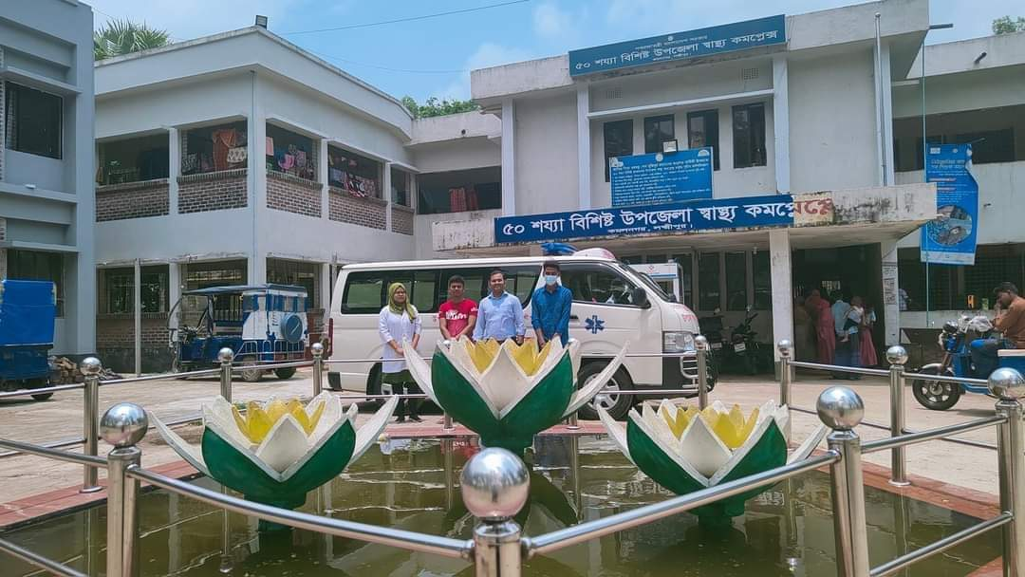
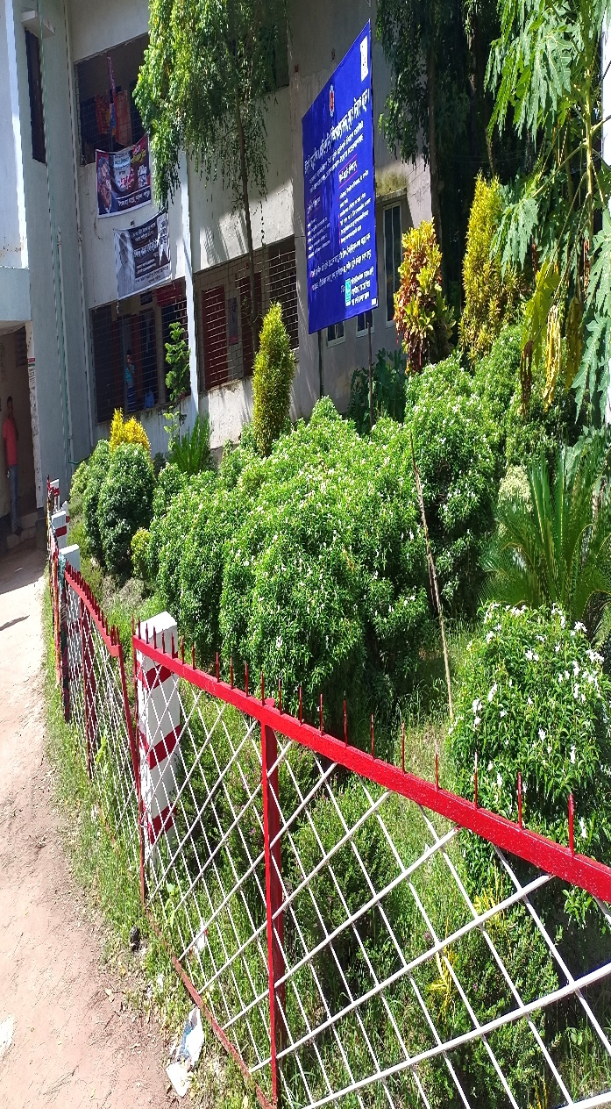
50 BEDED UPAZILA HEALTH COMPLEX
Kamalnagar, Lakshmipur.

Slide 2
Health Profile of kamalnagar Upazila- 2022
Total population : 217391
Total Fertile Couples : 34576
Total Pregnant : 1518
Total Delivery : 1737
Total Live birth : 1724
Total death : 13
Total Maternal death : 02
Health Man power
a. Doctor : 19 ( 11 + 8)
b. Nurse : 15
c. HA : 25
d. SBA : ( 2HA+4 FWA + 1CHCP)
e. Volunteer, Security guard & cleaner: 14
9. Health Institutions
a. Health Complex : 01
b. H & FWC : 4 (Sub-2 FWC– 2 )
c. Community clinic : 22
d. Non- Govt. Clinic : 02

Slide 3
10. Mother Taken-ANC : 143% ( 1st Visit)
11. Hospital Delivery Rate : 84.8% (3755)
12. No. of Hospital bed : 50
13. Bed Occupancy Rate :108%
14. Maternal Mortality Ratio : 42 / 100000 live Birth
15. Neonatal Mortality Rate : 16.7 / 1000 live birth
16. Infant Mortality Rate : 20.6 /1000 live birth
17. Under-5 Mortality Rate : 22.7 /1000 live birth

Slide 4
A Sub-district level Hospital with a Vision
Maximum utilization of Govt.
resources with
honesty and sincerity
Integrated approach of
Administration, Community
Leaders & Health
Management
Providing Effective and
prompt services
through improved
management system

Slide 5
Hospital activities done by Following committees
Our every activity done by team building.
1. Hospital Management committee
2.Committee for Monthly co-ordinating meeting
3. committee for weekly meeting
4.Diet monitoing committee
5.Waste management committee
6. House rent and residential committee
7.Financial committee for MSR
8. Committee for health education and awareness
9. Store management committee
10. Fire fighting, rescue and safty committee
11.Anti-sexual harasement committee.
12. Social and cultural activities celebration committee
13. Audit committee.

Slide 6
Our Co-ordinating function done
1. By regular physical monitoring and supervision
2. By using Technolgy
a. Messenger group
-Doctor messenger group
- EMO messenger group
-Nursing messenger group
- CHCP messenger group
- SACMO messenger group
- HI,AHI,HI messenger group
b. Mobile tracking system
3. By doing regular schedule meeting .

Slide 7
Background History of MCH services of kamalnagar health Complex, Lakshmipur
To reduce Maternal and Child Mortality and Mobility and to ensure the quality services to the mother and child, UHFPO opened 9 delivery centre in 9 union with the help of JICA in March 2021. And from March 2021 to june-2022 JICA helped by Frontline MCH Program.
4 Special activities:
ANC-Corner
NCD corner
Basic EOC service
Under 5 corner for under 5 children(IMCI)
Monthly birth and death record

Slide 8
Contd.
From Dec. 1999 Reproductive Health Department of DGHS and UNICEF gave logistic supports and human resources development .
Form November 2000 started Comprehensive EOC program.
From 2022 Safe Blood Transfusion unit established after establishing the pathology department.
Essential packages(one month) for ANC patient started from august 2021.
Women and child friendly Hospital declared in 2021.
Major Killer Disease (diabetes, hypertension (NCD Corner), RTA & poisoning) prevention program starts in 1st January-2021
KMC and SAM corner started from January 2021.
VIA corner for screening of cervical cancer will be started very soon.

Slide 9
Our different Services and developments :

Slide 10

UHC
Bed Occupancy Rate from 2017 to 2022

Slide 11
Emergency & Out Door, Indoor Service 2017 to 2022
UHC

Slide 12
Comparative data of revenue income (in Taka) from 2017 to 2022
UHC

Slide 13
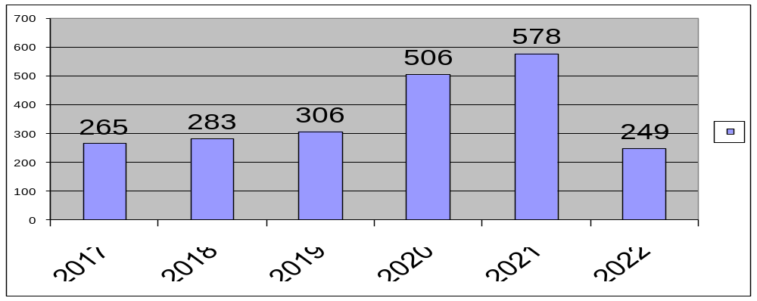
Upazila Health Complex kamalnagar, Lakshmipur.
EOC Activities : 2017 to 2022 (Hospital Delivery )

Slide 14
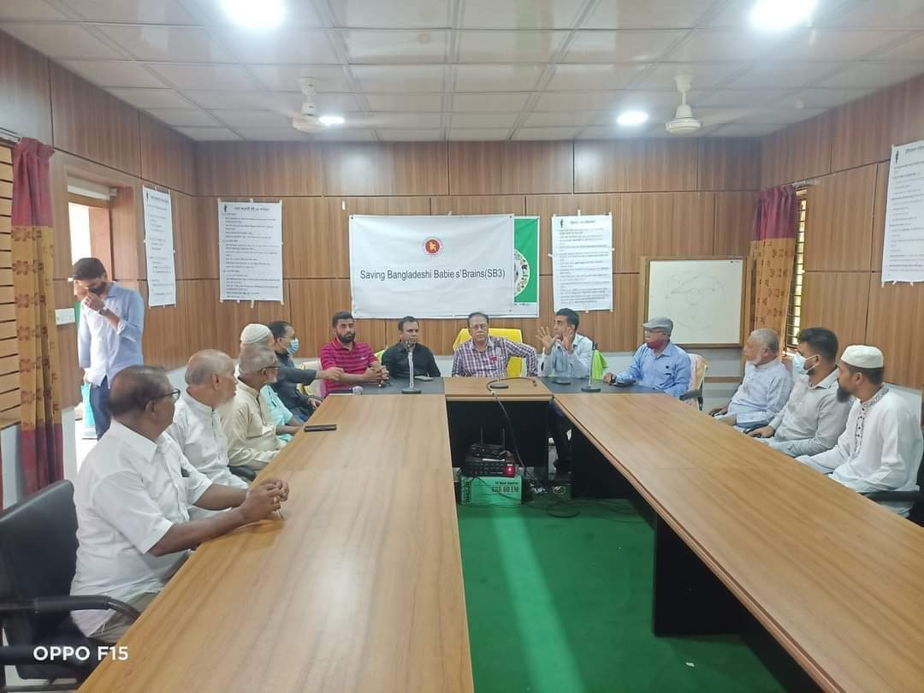
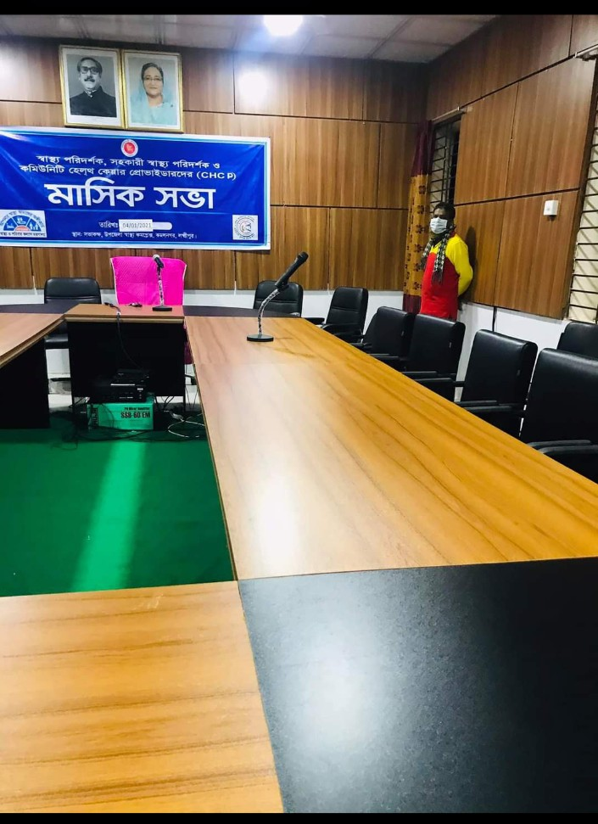
Well-decorated conference room.july 2020

Slide 15
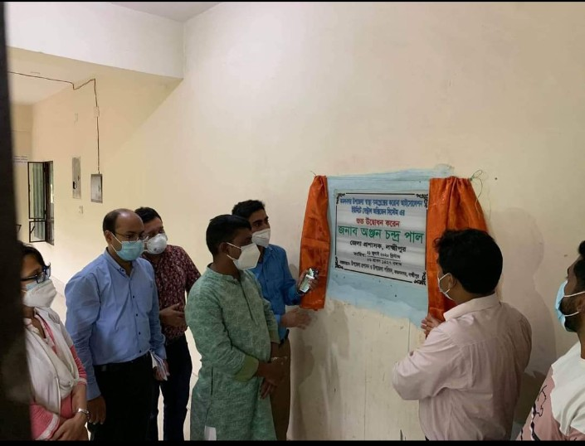
Establishment of Central Oxygen system,july 2020.

Slide 16
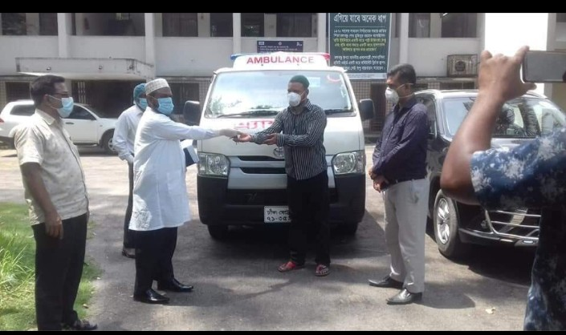
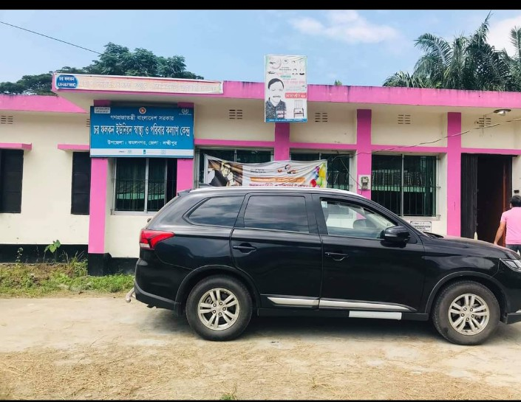
Receiving of Ambulance and Jeep keys from CS Sir ,august 2020.

Slide 17
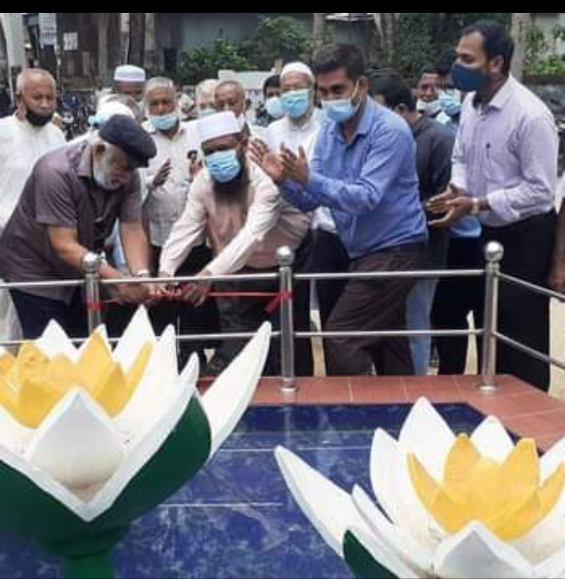
Muktijudda Shapla Chattor inaugurated by CS Sir and Muktijudda commander,sep,2021

Slide 18
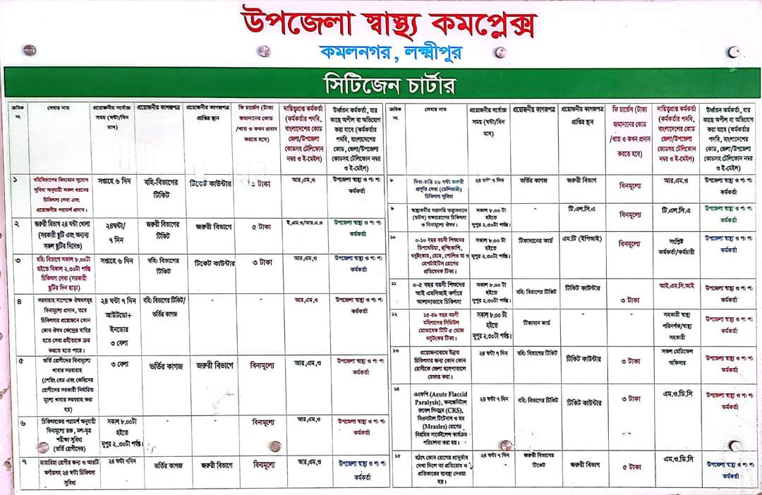
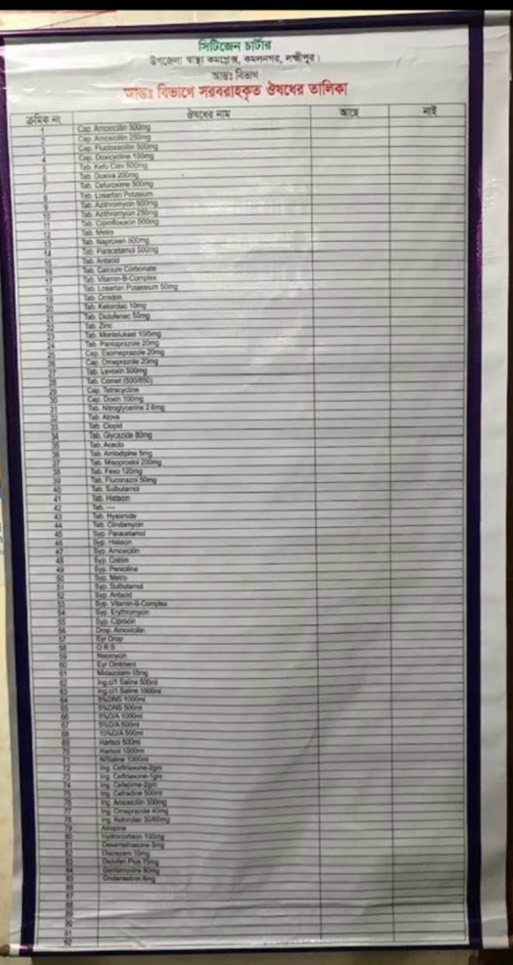
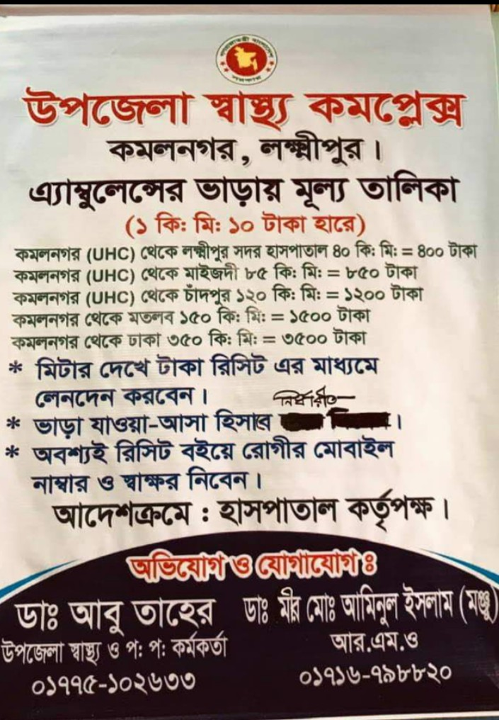
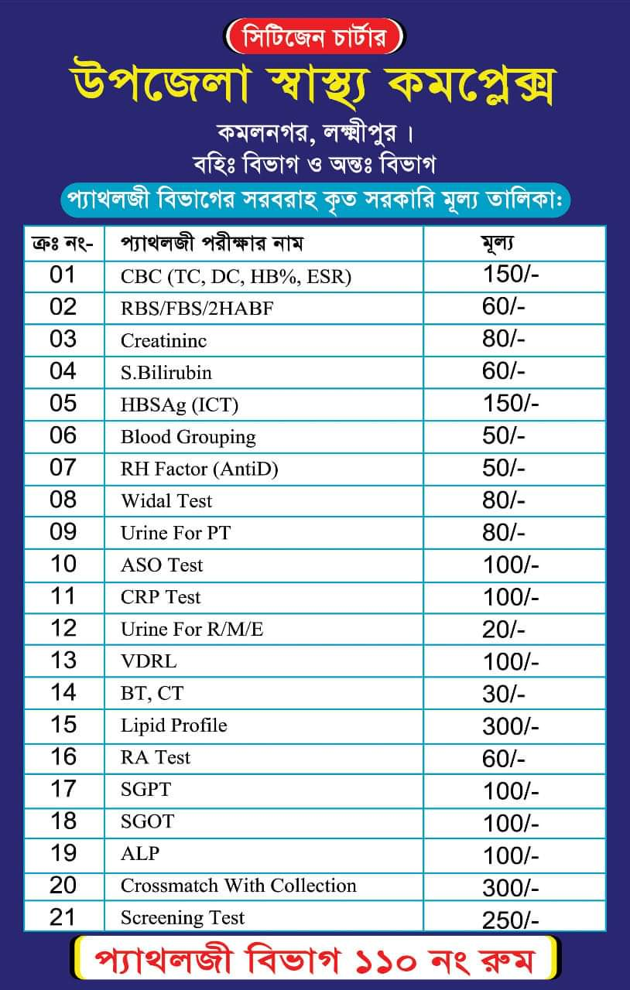
Citizen charter, value and medicine list added 2021

Slide 19
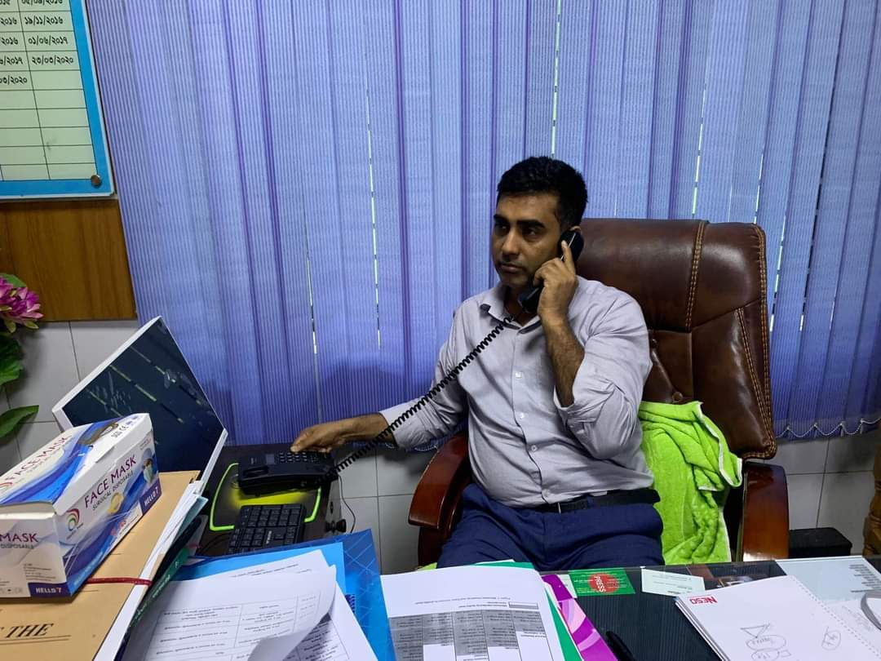
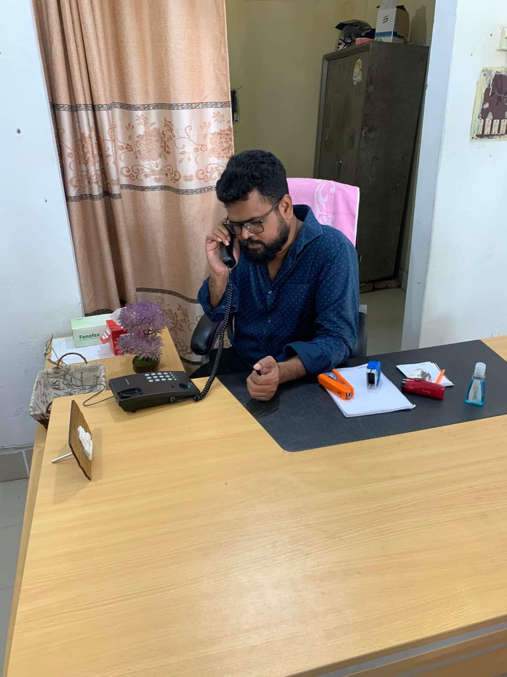
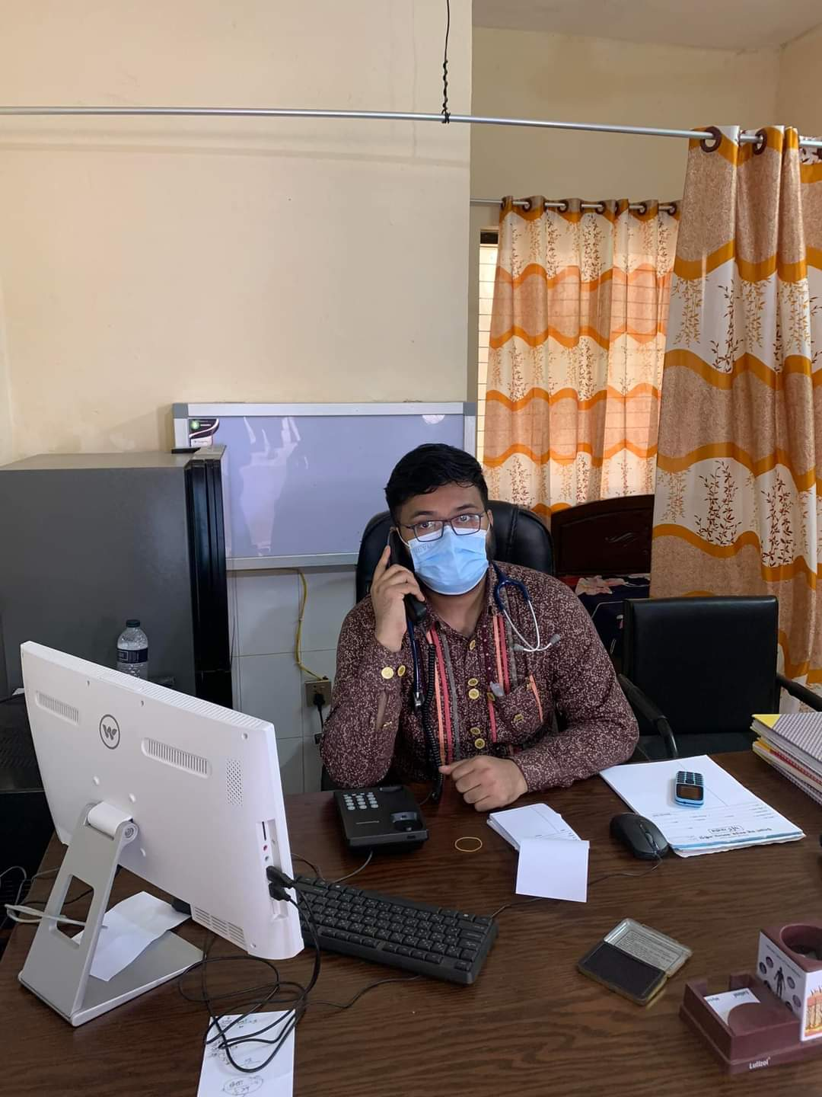
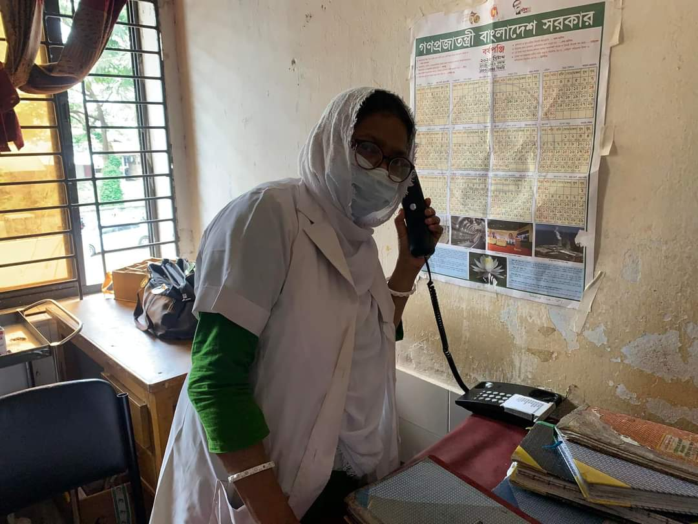
Intercom added march 2022.

Slide 20
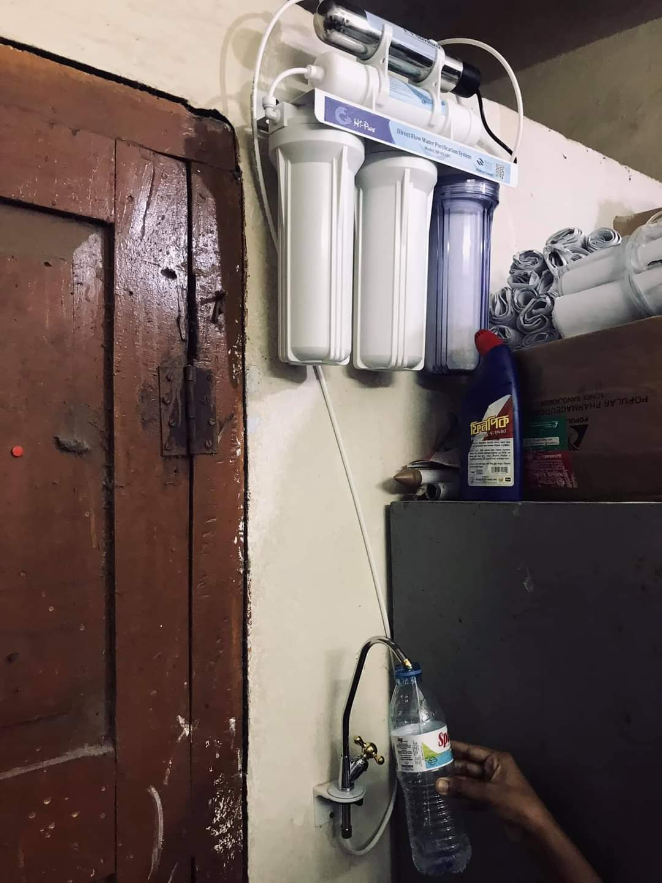
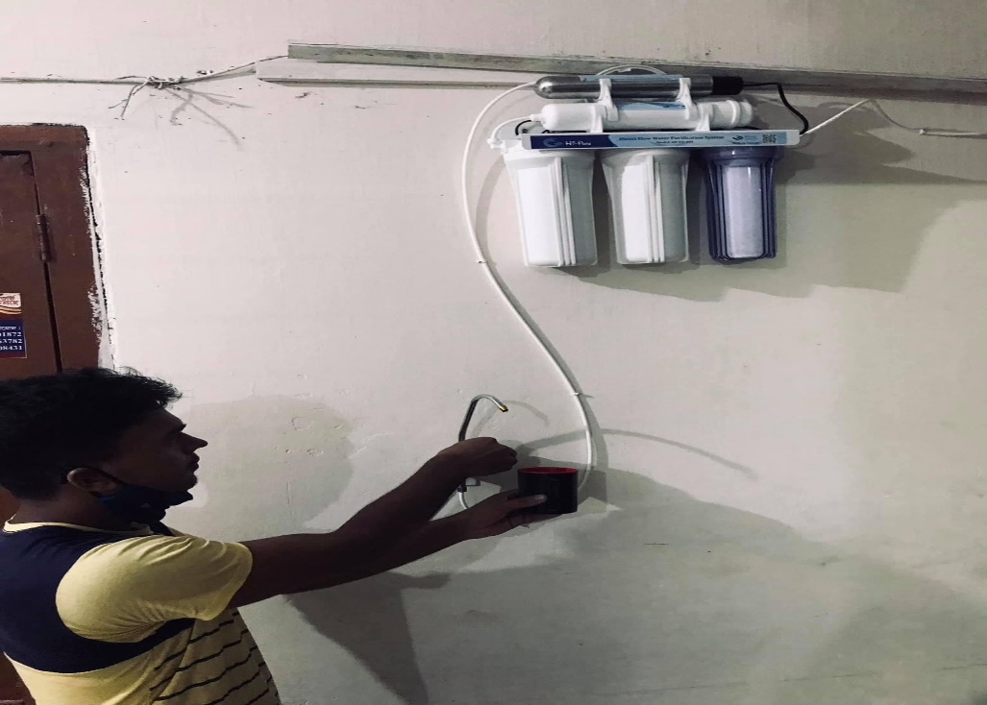
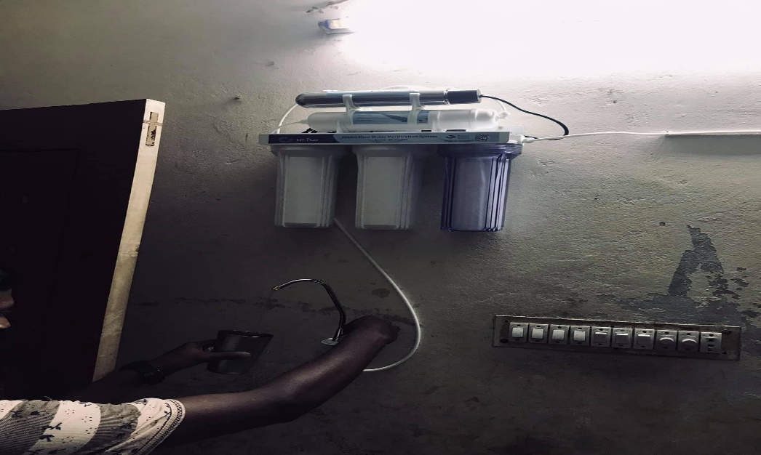
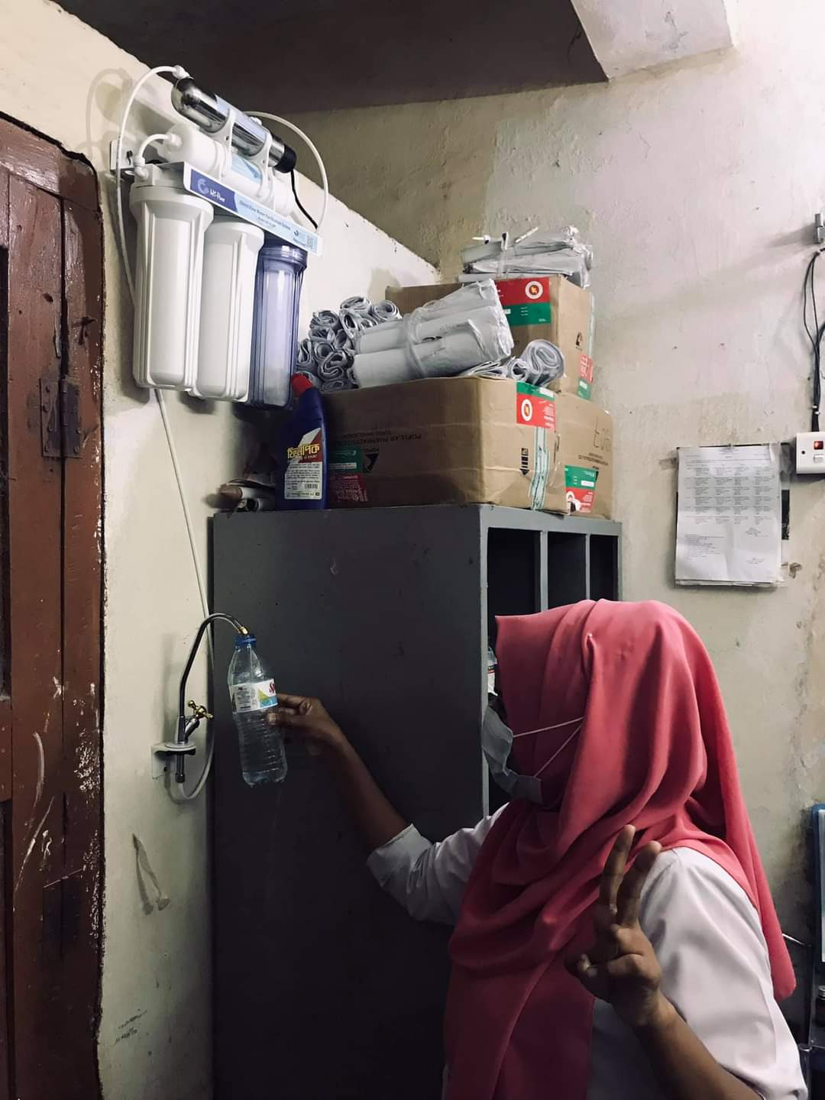
Safe drinking water system added in july 2021

Slide 21
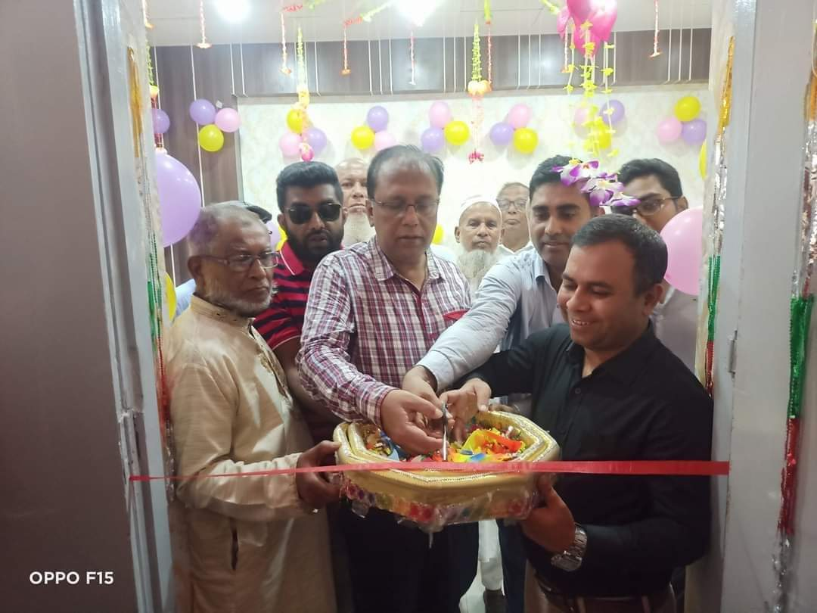
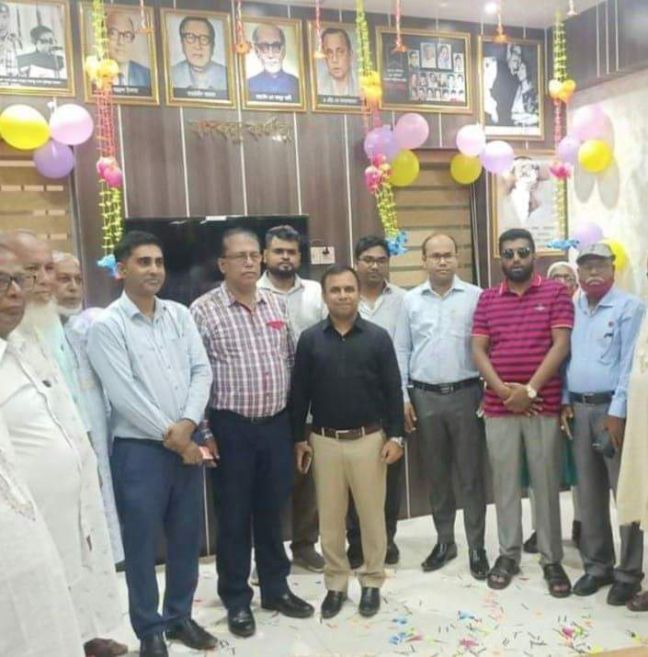
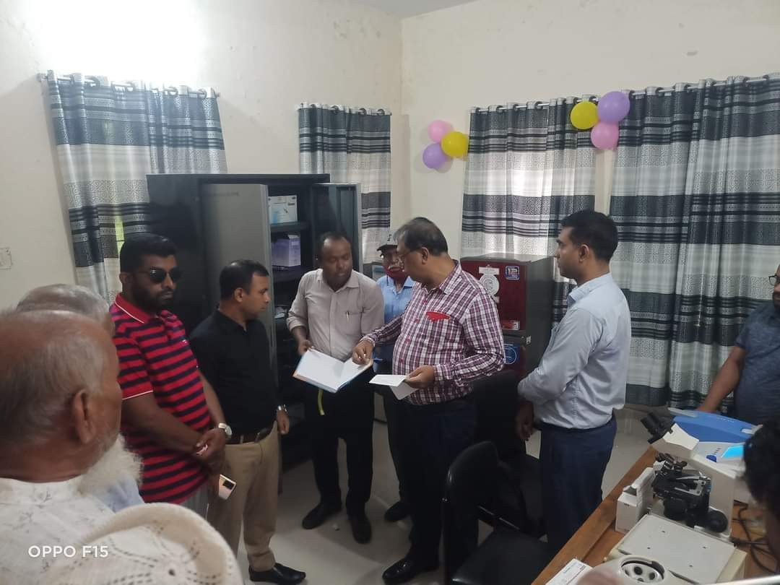
Inauguration of Pathology department, NCD Corner and Banghobondhu Corner 2022,july

Slide 22
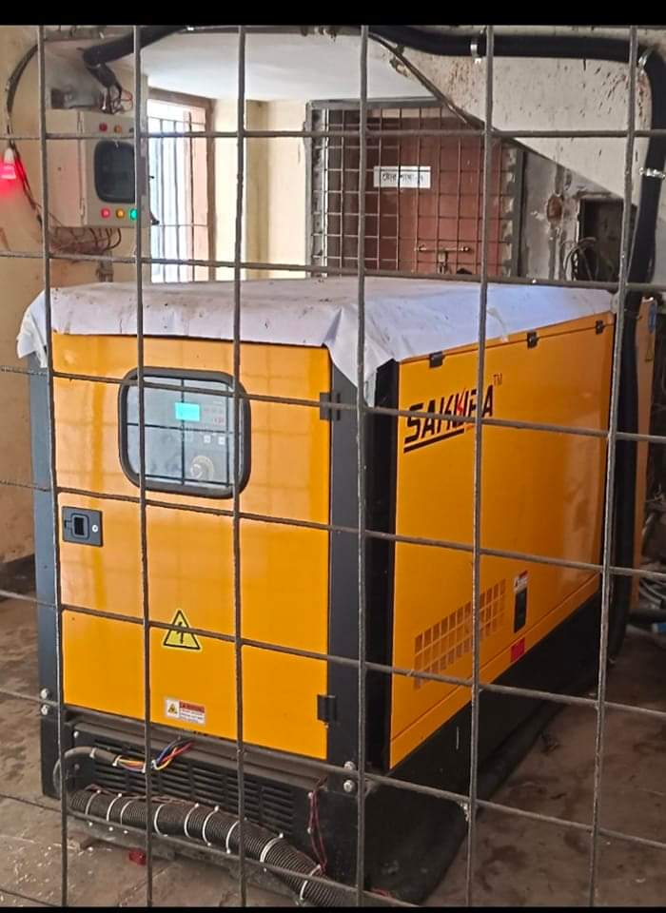
New Generator added june 2022

Slide 23
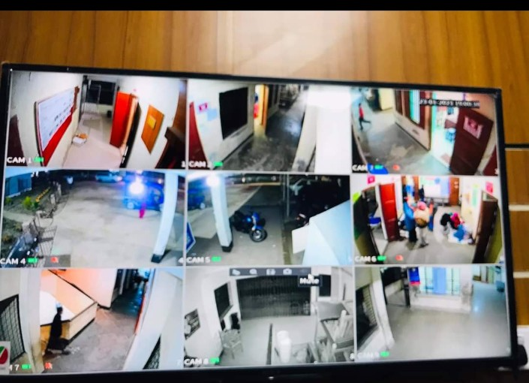
Whole hospital is controlled by CC Cemera added in September 2021.

Slide 24
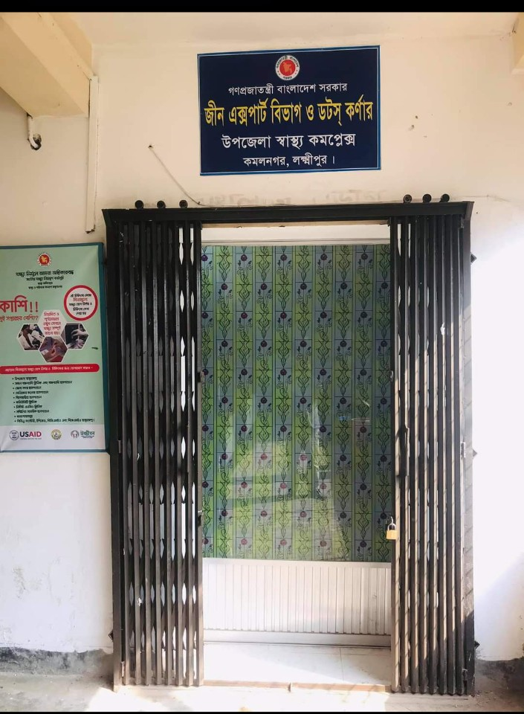
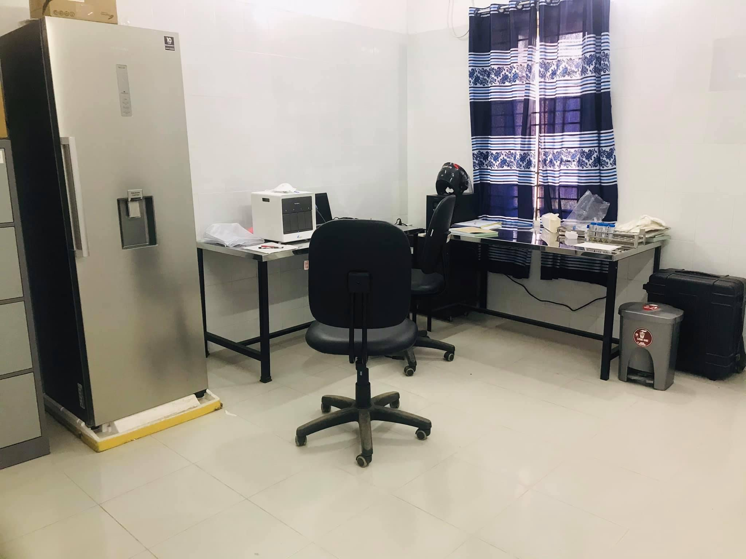
Gene X-pert and Dots corner added December 2021

Slide 25
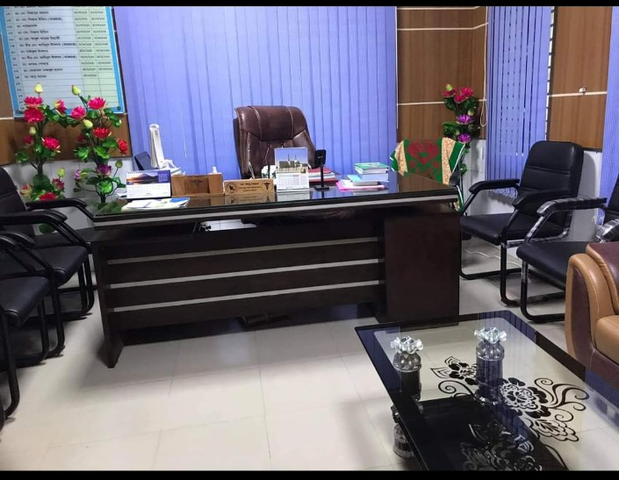
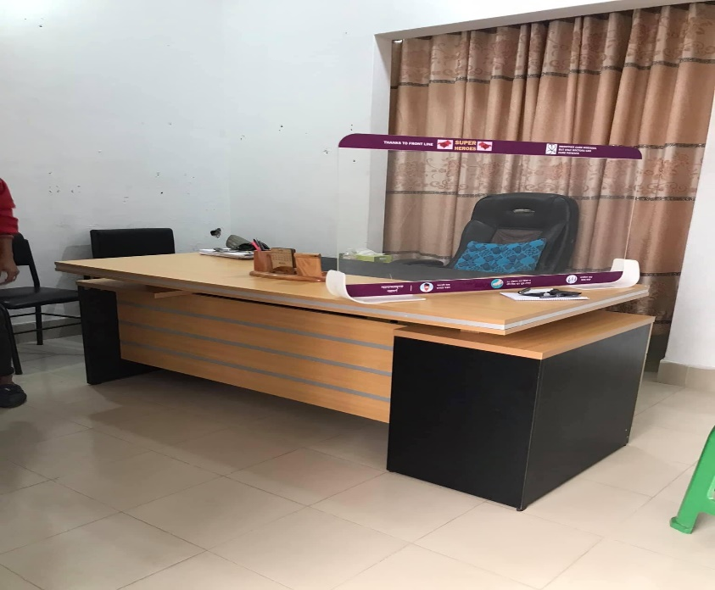
Well furnished UHFPO room(2020),RMO room(2021),EMO room(2022)

Slide 26

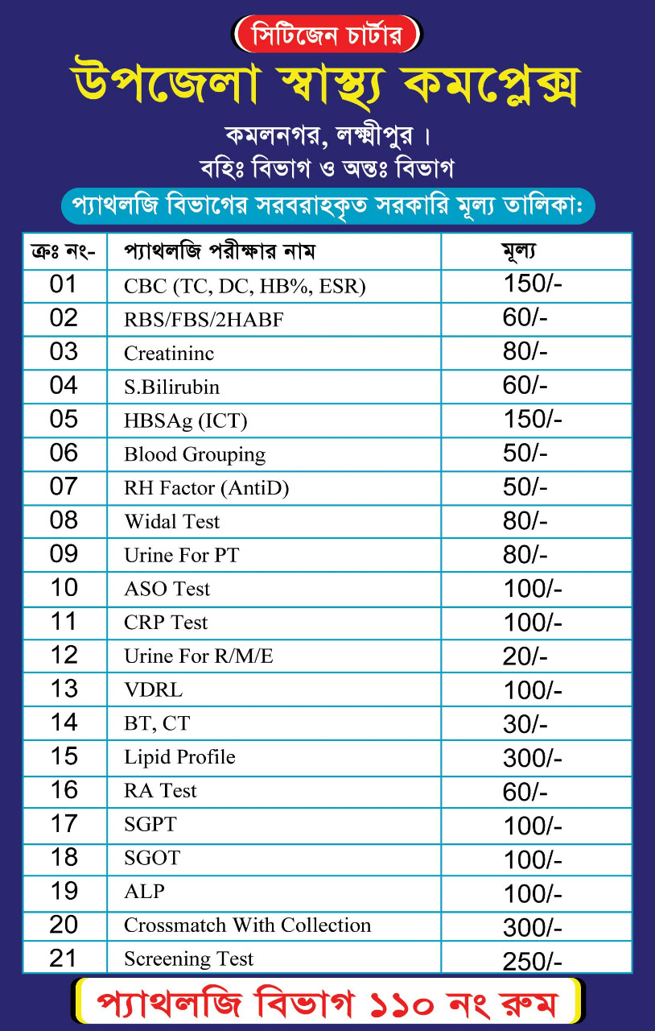
2022,july

Slide 27
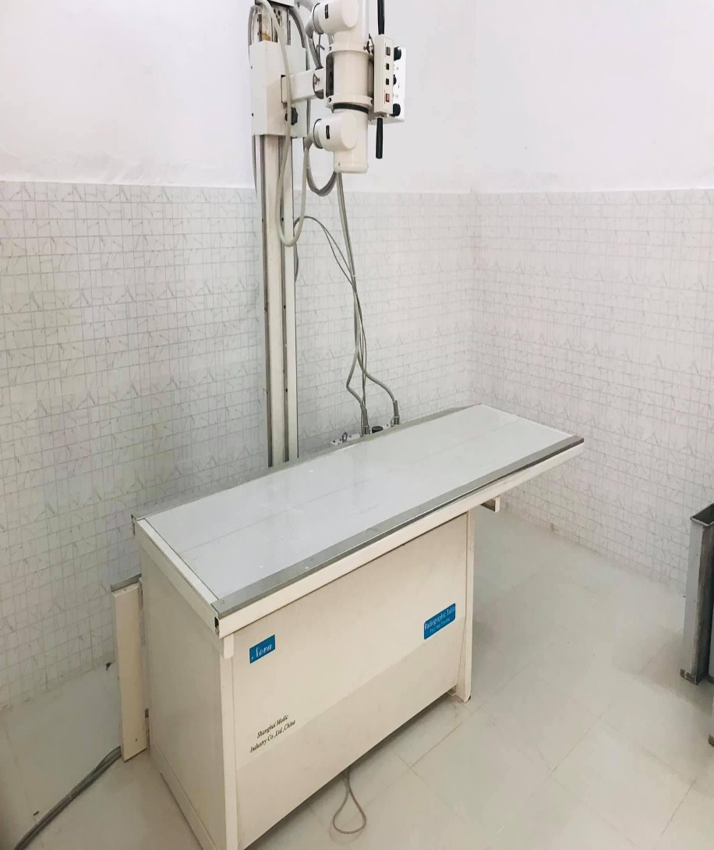
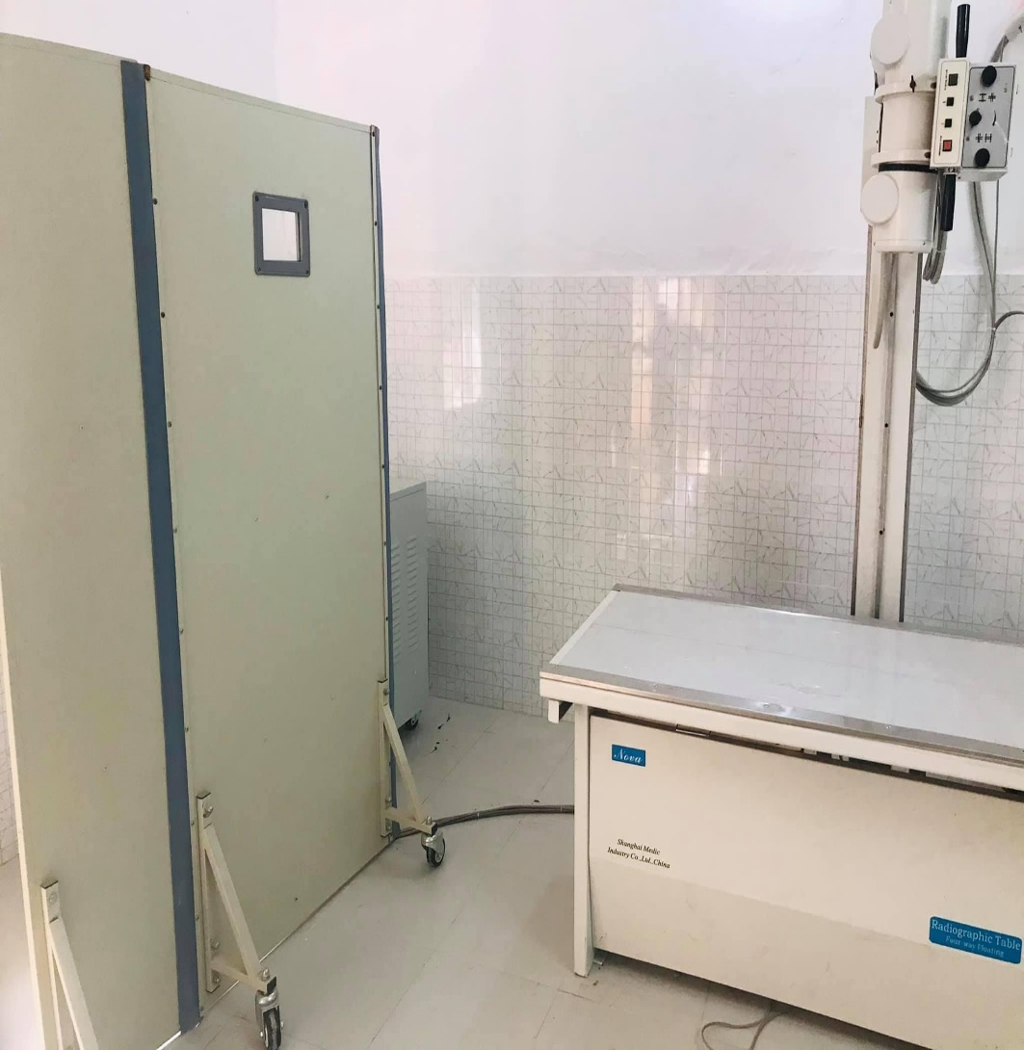
X-ray department added November 2020

Slide 28
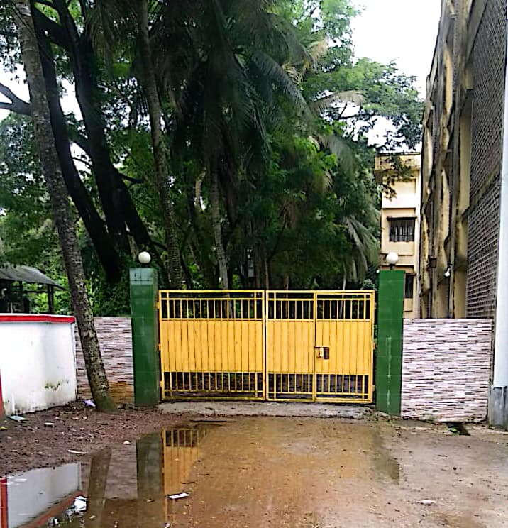
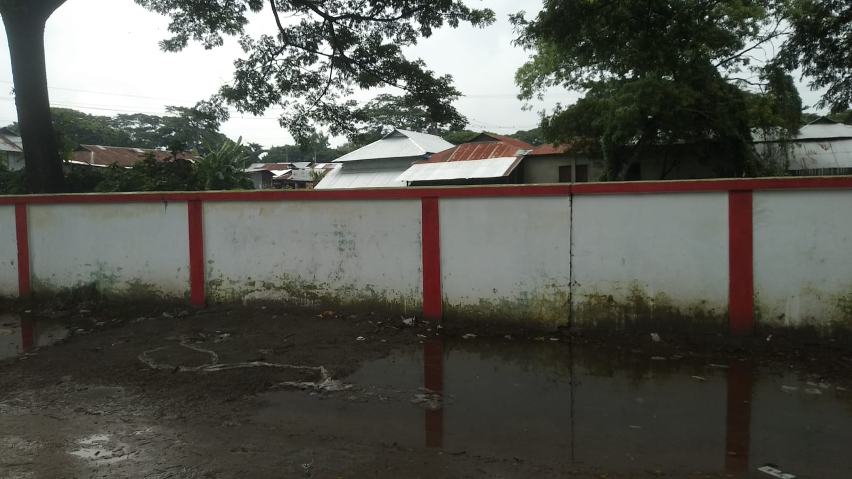
Hospital boundary wall and residential gate construction 2021

Slide 29
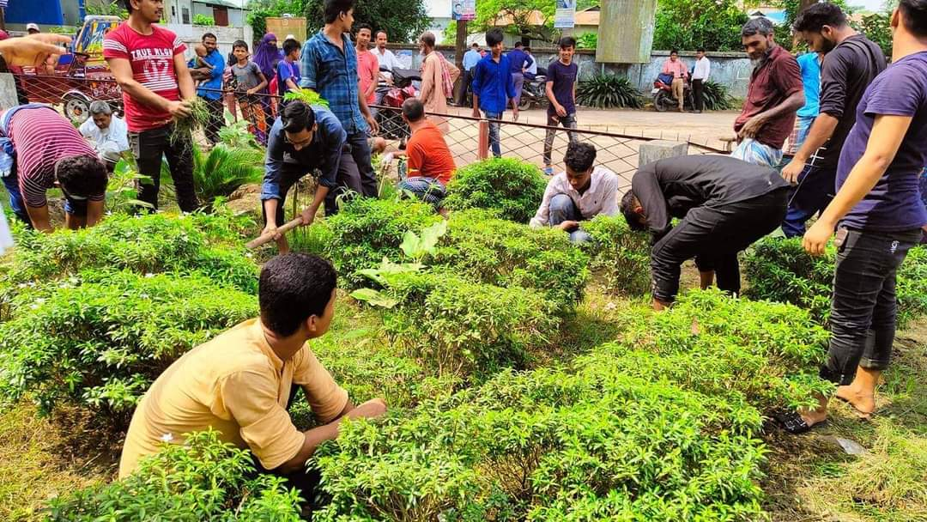
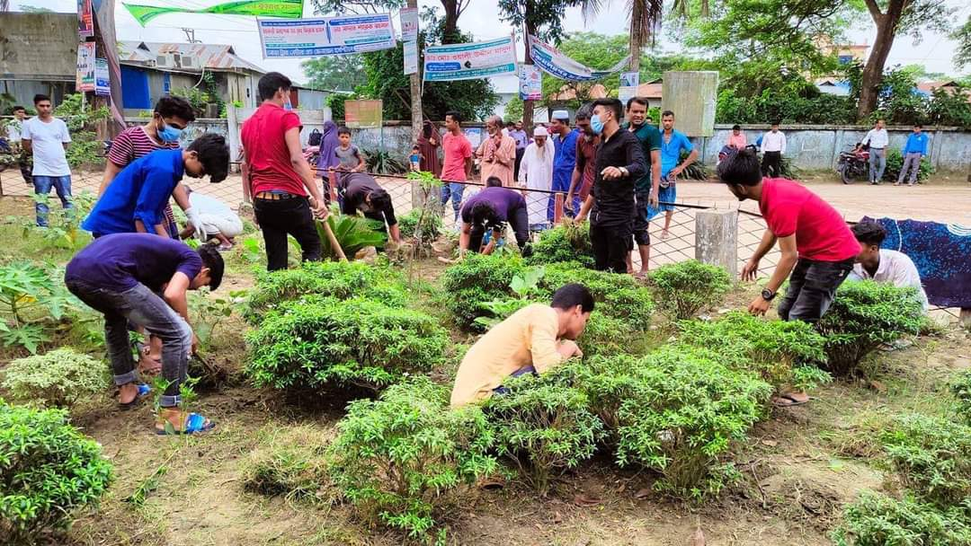
Gardening & Cleaning day,
Every Thursday.

Slide 30
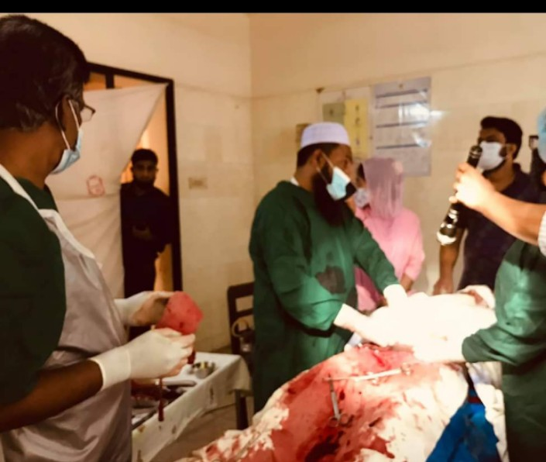
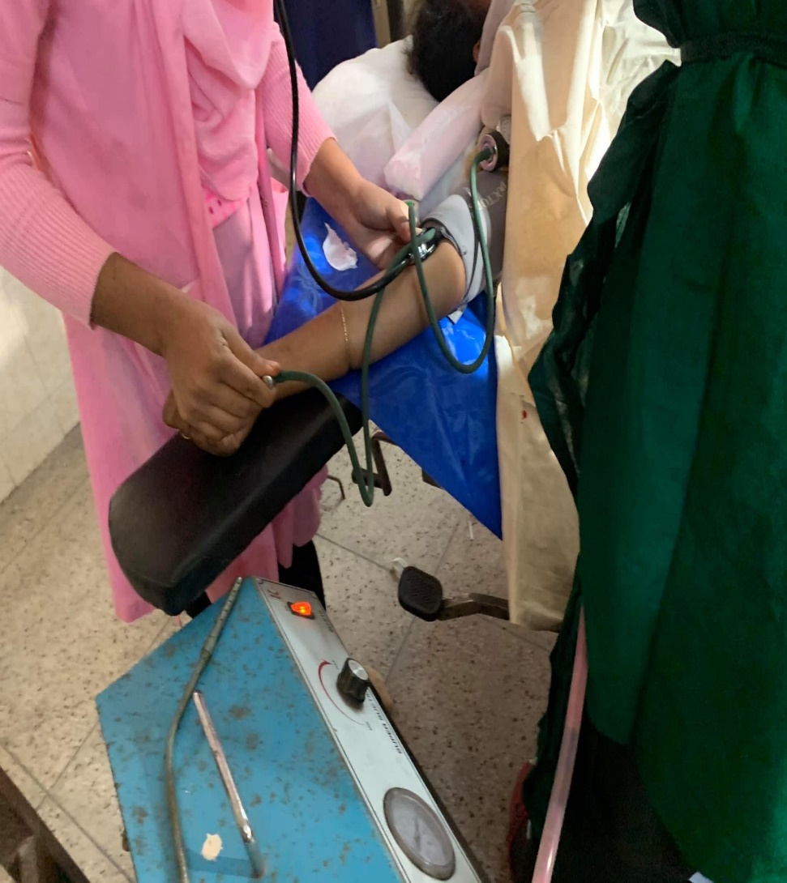
Upazila Health Complex kamalnagar, C section 2021

Slide 31
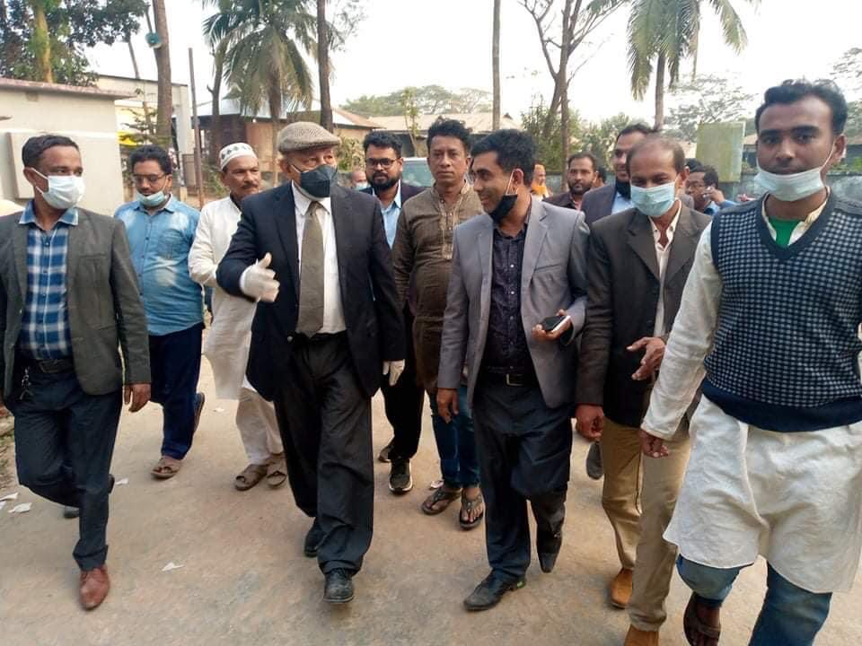
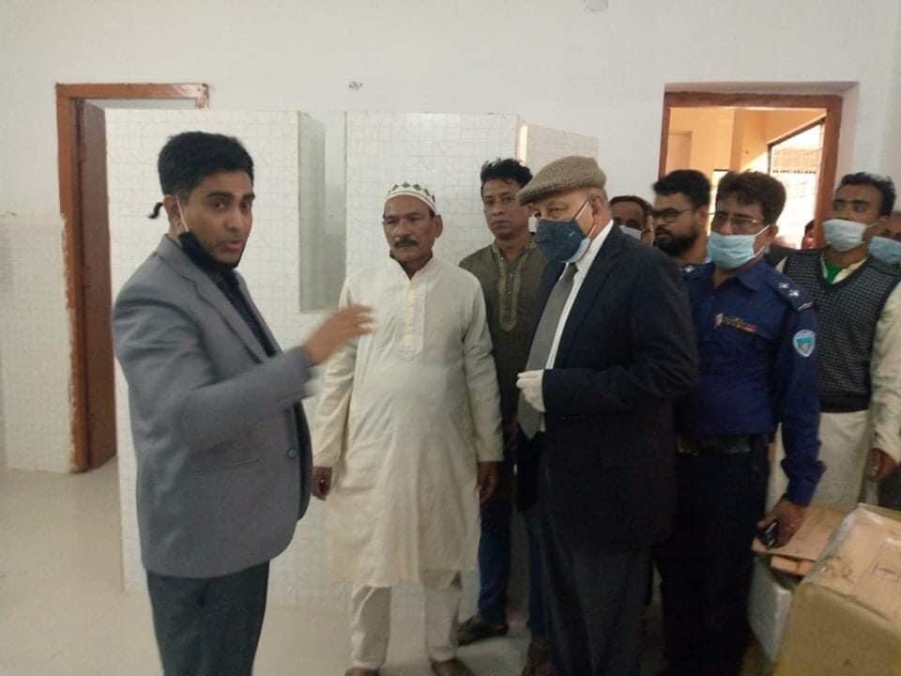
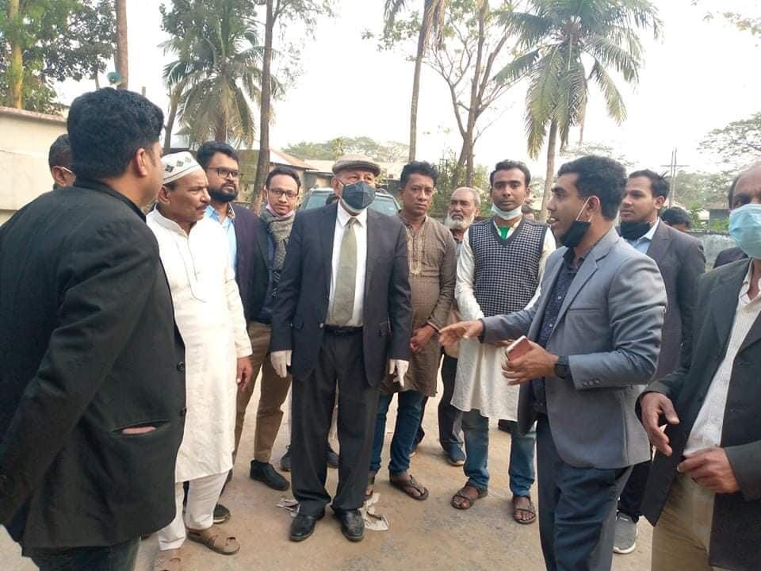
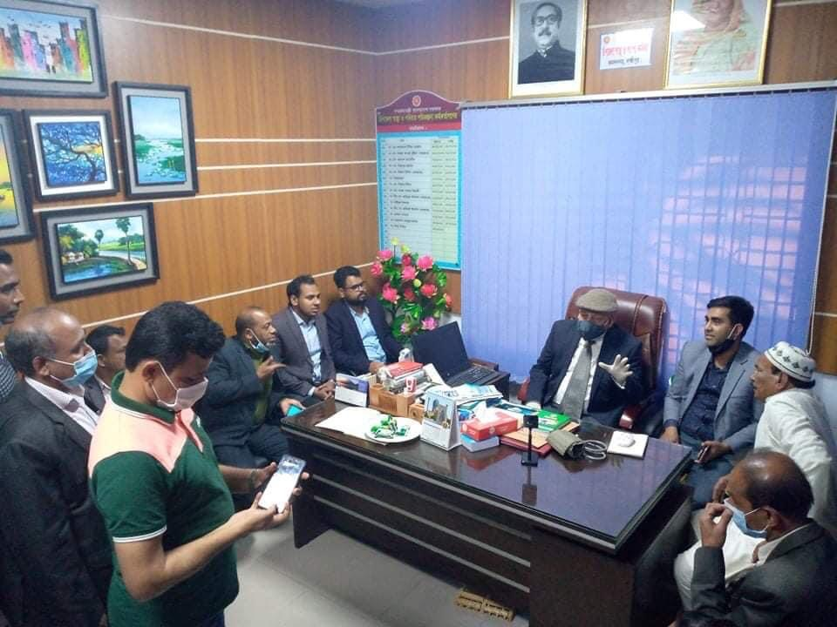
Inspection by MP,Major(Rtd) Abdul Mannan, 11 feb 2021

Slide 32
Upazila Health Complex kamalnagar, pathlogy visit CS Sir

Slide 33
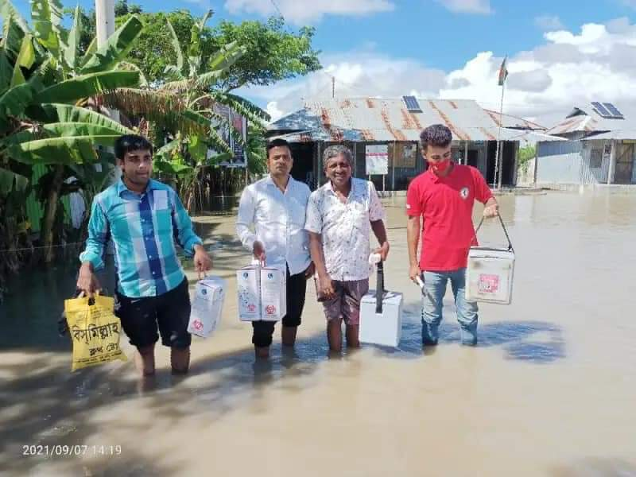
Upazila Health Complex kamalnagar, EPI Centre Risk

Slide 34
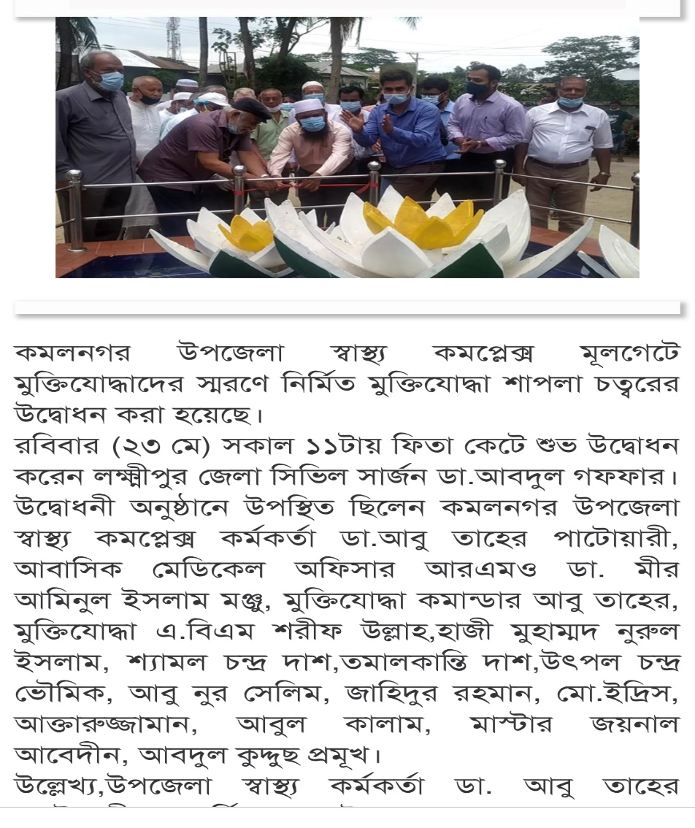
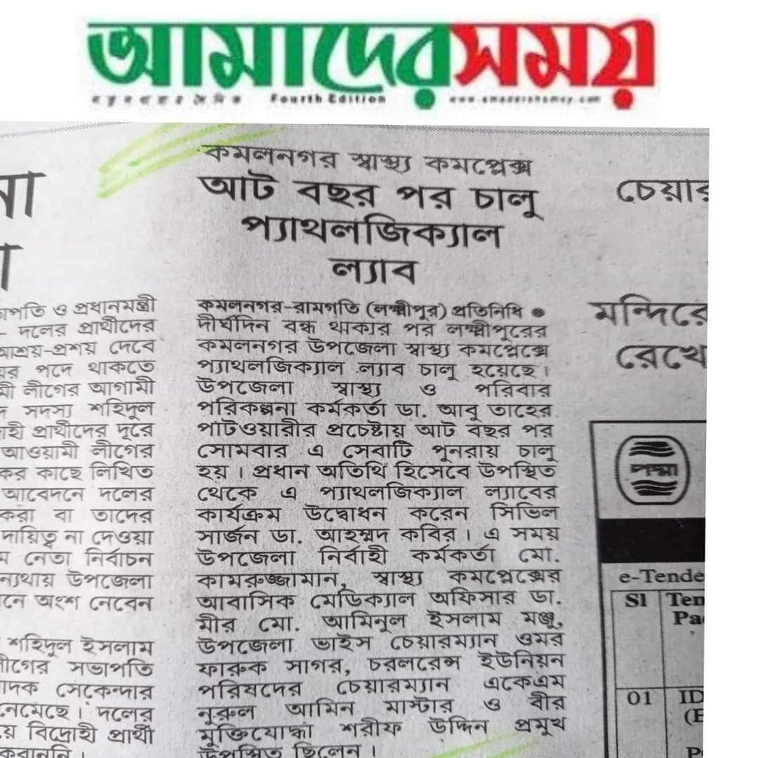
News paper coverage

Slide 35
Upazila Health Complex kamalnagar, Lakshmipur.
Community Support
One IPS & delivery instruements financed by JICA for 10 delivery centres in each union.
Central oxygen system financed and organiged by Upazila Parishad.
Blood donated by about 100 enlisted blood donors in emergency need (Transfusion of 165
bag F/blood are given in 2021,2022)
Fuel of Generator donated by MP and Upazilla Parishad .

Slide 36
Our achievements
Our upazila is near Meghna river and it is continuous flooded and eroded and very hard to risk area.Moreover-
#Our corona vaccine coverage-
> 1st dose-86.25%
>2nd dose-81.3%
# EPI coverage-99.99%
# Our hospital activity will be controlled by automation system very soon.

Slide 37
Challenges
1. Change the attitude.
2. Fill up remaining 45% human resouces.and cancelletion of attachment post.
3. Construction and reconstruction of infrastructures specially
- Store building
-repair old building and new building
4. UHFPO residence, Quarter and Dormitory construction.
5. Construction of River broken 4 CC.
6. Creation of post in favour of 50 bed.
7. SSK establishment is a challenge.
-

Slide 38


